Slide 1
Regression Analysis
Analysis of Variance
Nicoleta Serban, Ph.D.
Professor
School of Industrial and Systems Engineering
ANOVA R Example

Slide 2

About This Lesson

Slide 3

Cancer Survival
Reference:
Cameron, E. and Pauling, L. (1978) Supplemental ascorbate in the supportive treatment of cancer: re-evaluation of prolongation of survival times in terminal human cancer. Proceedings of the National Academy of Science USA, 75, 4538-4542.

Slide 4
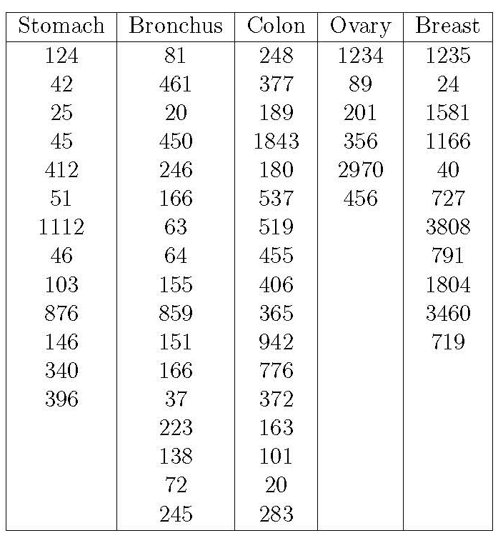
ANOVA Example Data
Response Variable:
Y_{ij}= The number of survival days for the j^{th} patient with i^{th} type of cancer
Categories:
Cancer type i for i = 1,2,3,4,5

Slide 5
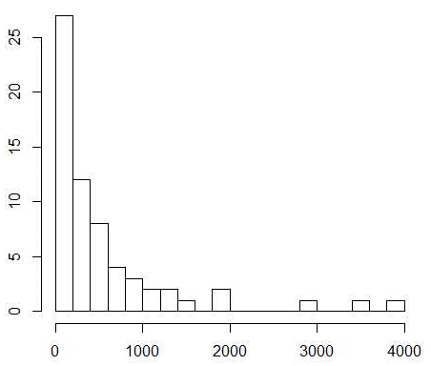
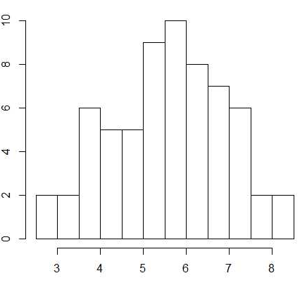
Exploratory Data Analysis in R
## Read data with 'read.table' R command for reading ASCII files
cancer_data = read.table("CancerStudy.txt", header=T)
## Response Variable
survival = cancer_data$Survival
## Explore the shape of the distribution of the response variable
hist(survival, xlab="", ylab="Number of Survival Days", main="", nclass=15)
## Transform due to skewness of the distribution
hist(log(survival), xlab="", ylab="Number of Survival Days", main="", nclass=15)

Slide 6
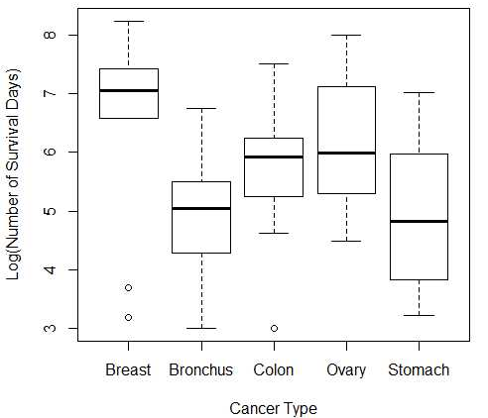
ANOVA in R
## Need to specify Response & Categorical Variables
survival = log(survival)
cancertype = cancer_data$Organ
## Convert into categorical variable in R
cancertype = as.factor(cancertype)
boxplot(survival~cancertype, xlab = "Cancer Type", ylab = "Log(Number of Survival Days)")….
Within-variability – some groups have higher variability than others
Between-variability – there is some variability between the means of the five groups
Is the between-variability significantly larger than the within-variability?

Slide 7
ANOVA in R (cont’d)
## ANOVA in R: Is the between-variability significantly larger than within-variability
model = aov(survival ~ cancertype)
summary(model)
Df Sum Sq Mean Sq F value Pr(>F)
cancertype 4 24.49 6.122 4.286 0.00412 **
Residuals 59 84.27 1.428
---
Signif. codes: 0 ‘***’ 0.001 ‘**’ 0.01 ‘*’ 0.05 ‘.’ 0.1 ‘ ’ 1
## Obtain estimated means
model.tables(model, type="means")
Tables of means
Grand mean
5.555785
cancertype
Breast Bronchus Colon Ovary Stomach
6.559 4.953 5.749 6.151 4.968
rep 11.000 17.000 17.000 6.000 13.000

Slide 8
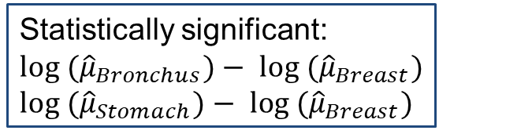
Pairwise Comparison in R
## Which means are statistically significantly different? Pairwise Comparison
TukeyHSD(model)
Tukey multiple comparisons of means
95% family-wise confidence level
Fit: aov(formula = survival ~ cancertype)
$cancertype
diff lwr upr p adj
Bronchus-Breast -1.60543320 -2.906741 -0.3041254 0.0083352
Colon-Breast -0.80948110 -2.110789 0.4918267 0.4119156
Ovary-Breast -0.40798703 -2.114754 1.2987803 0.9615409
Stomach-Breast -1.59068365 -2.968399 -0.2129685 0.0158132
Colon-Bronchus 0.79595210 -0.357534 1.9494382 0.3072938
Ovary-Bronchus 1.19744617 -0.399483 2.7943753 0.2296079
Stomach-Bronchus 0.01474955 -1.224293 1.2537924 0.9999997
Ovary-Colon 0.40149407 -1.195435 1.9984232 0.9540004
Stomach-Colon -0.78120255 -2.020245 0.4578403 0.3981146
Stomach-Ovary -1.18269662 -2.842480 0.4770864 0.2763506
Statistically significant:
$${{log (\hat{μ}}_{Bronchus})− log (\hat{μ}}_{Breast})$$
${{log (\hat{μ}}_{Stomach})− log (\hat{μ}}_{Breast})$

Slide 9
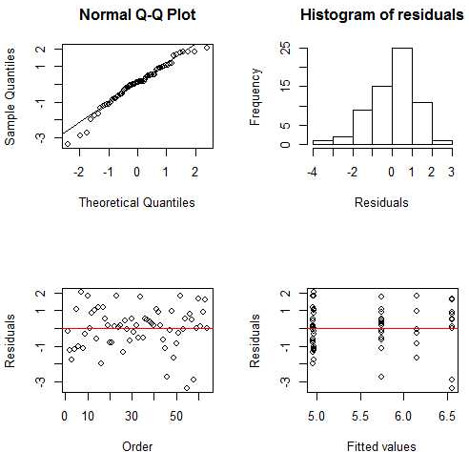
Residual Analysis in R
par(mfrow=c(2,2))
qqnorm(residuals(model))
qqline(residuals(model))
hist(residuals(model), main="Histogram of residuals", xlab="Residuals")
plot(residuals(model), xlab="Order", ylab="Residuals")
abline(0, 0, lty=1, col="red")
plot(fitted(model), residuals(model), xlab="Fitted values", ylab="Residuals")
abline(0, 0, lty=1, col="red")
The quantiles align on the line and the histogram is approx. symmetric thus normality assumption holds
Residuals are scattered around zero line with no pattern thus both the constant variance and uncorrelated errors hold

Slide 10
Cancer Survival: Findings
There is strong evidence for the difference in the survival time across the five different types of cancer;
Survival time: Breast cancer vs. Bronchus or Stomach cancer.

Slide 11

Summary

